Slide 1


Slide 2

predict whether an individual's income exceeds a certain threshold.

Slide 3
Agenda
Problem Statement 03
Data Mining - 01 04
Data Mining - 02 05
Exploratory Data Analysis (EDA) 06
Data Visualization 07
Algorithms Used 08
Analysis of Results 09
Conclusion & Future Work 10

Slide 4
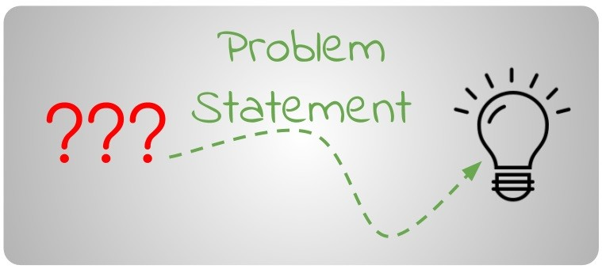
Problem Statement
predict whether an individual's income exceeds a certain threshold (e.g., $50,000 per year) based on their occupation and other relevant attributes.
This model is then used to identify whether an individual's income exceeds a certain threshold or not.
Question: whether an individual's income exceeds a certain limit or not(less than or equal to and greater than $50,000 per year)
Solution: Involves looking on their occupation and other relevant attributes.

Slide 5
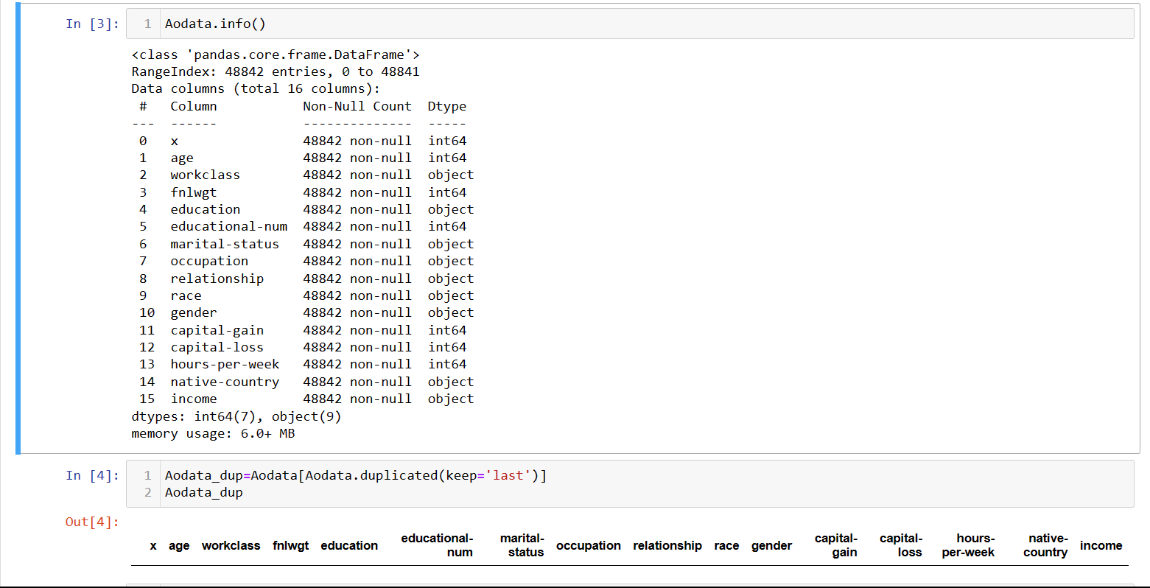
Data Mining - 01
Data Preprocessing
Data Cleaning:
This involves identifying and correcting errors or inconsistencies in the data, such as missing values, outliers, and duplicates.
Various techniques can be used for data cleaning, such as removal, and transformation.

Slide 6
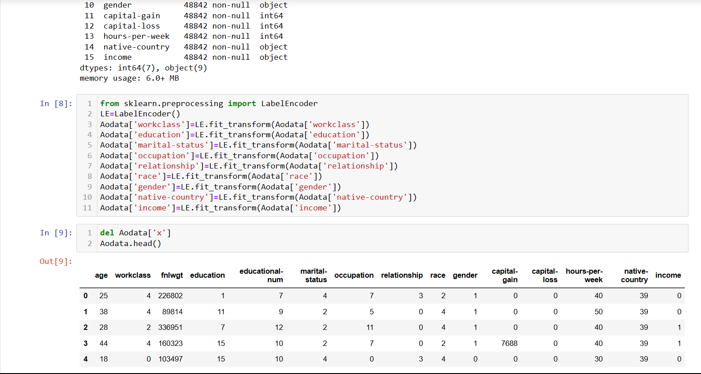
Data Mining - 02
Data Preprocessing
Data Transformation(Label-Encoding):
This involves converting the data into a suitable format for analysis.It include normalization, standardization, and discretization.
Label-Encoding is used to convert Catagorical data into discrete categories.

Slide 7
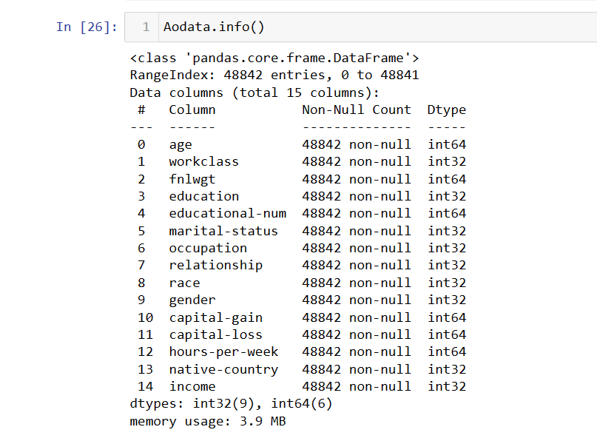
Exploratory Data Analysis (EDA)
Exploratory Data Analysis (EDA) is a crucial step in the data analysis process. It involves analyzing and summarizing data to gain insights, identify patterns, detect outliers, and understand the underlying structure of the dataset. EDA helps data scientists and analysts to better understand their data before applying any statistical modeling or machine learning techniques. Here are some common steps involved in exploratory data analysis:
Data Collection
Data Exploration
Feature Engineering
Correlation Analysis
Data Transformation
Outlier Detection

Slide 8
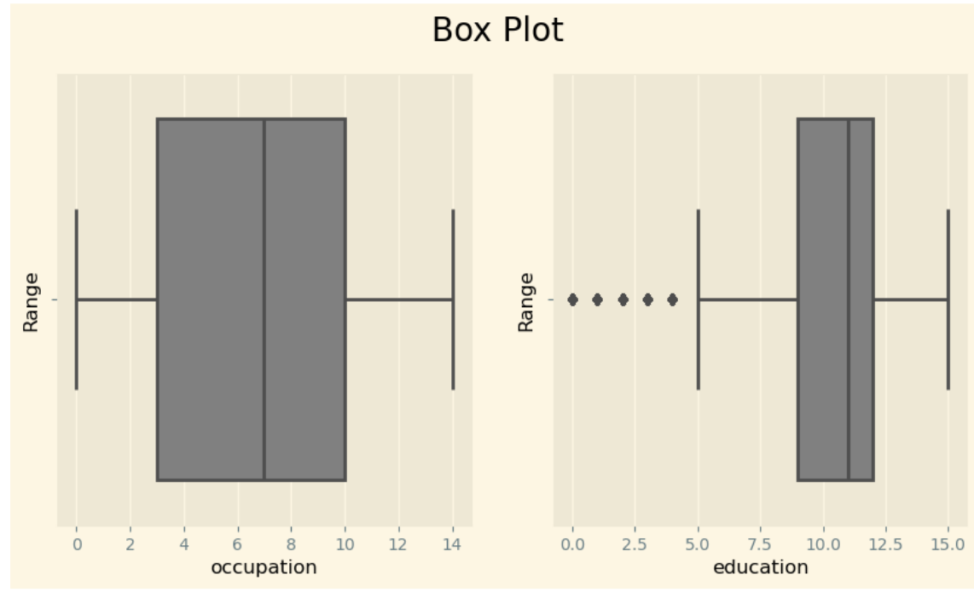
Data Visualization
A box plot, also known as a box-and-whisker plot, is a statistical visualization tool that provides a concise summary of the distribution of a dataset. It displays the data's median, quartiles, and potential outliers, allowing you to quickly understand the key features of the data's spread and identify any unusual values.

Slide 9
Algorithms Used
Our problem is classification problem.
There are total seven algorithms in classification problems
Logistic Regression
Decision Tree Classification
Random Forest
Extra Trees Classification
KNN Algorithm
SVM Algorithm
Naïve Bayes Algorithm
Among 7 algorithms, in KNN algorithm there is a need to find the highest accuracy k value
And also there are 4 types of models are there in SVM Algorithm

Slide 10
Analysis of Results
From KNN Algorithm k=2 gives the best accuracy About 81.7%.
Random Forest gives the best accuracy About 86.3%.
Extra Trees Algorithm Also Gives Best Accuracy About 85.0%.

Slide 11
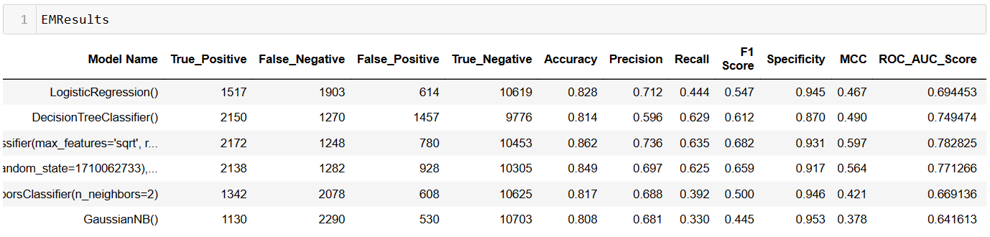
Conclusion and Future Work
After evaluating various algorithms, we have found that Random Forest Algorithm achieves the highest accuracy among them
Therefore, we will utilize the Random Forest algorithm to predict the income range of an individual in our Model.
And By Finding and Removing The outliers there may be chance of increase of Accuracy in our model

Slide 12
Thank You
Q & A
Student Name: MEDIMUDI SRINIVASA RAVITEJA
Roll Number:21B91A04E2
SRKR Engineering College
Mobile: +91 8374955672
Email: 21B91A04E2@srkrec.ac.in
Bhimavaram - India

